Slide 1
Advising is a Complicated Profession
Advisors are on the front lines and are thrust into multiple roles to support our students
There are multiple stressors that are inherently part of the job that are so separate from why you got into this work
In addition to the short-term challenges, these stressors can lead to burnout and long-term health issues
And of course its all exacerbated by COVID

Slide 2
Why you got into this work
When working to accomplish a goal, research shows that we are able to be more focused and emotionally resilient in the face of significant stressors when we are remain fully aware of why we wanted to accomplish the goal in the first place
This applies very well to the motivations that got you into advising
It’s very hard not to focus on all the stressors (especially right now) in your job, but lets take a step back and write a brief paragraph about why you got into this work and/or what you deeply love about it (3 min)
Lets have a brief discussion about what you wrote

Slide 3
Emotional Wellness Tips for Advisors
We will focus on wellness tips to keep yourself healthy and to understand some of the emotional wellness struggles interfering with the success of your advisees
Acknowledgement: Efforts today are complicated/supported by the fact that we are simultaneously focusing on emotional wellness of your student and yourself
In an hour there isn’t a lot we can do thoroughly so we will touch on three different approaches
Behavioral strategy to address stress both in the moment and proactively
Motivational framework to understand willingness to make changes
Cognitive-behavioral approach to understand problematic choices we/others make

Slide 4
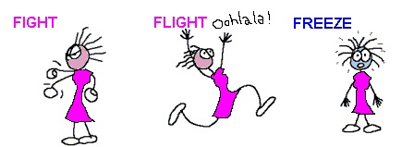
The Stress Response
The autonomic nervous system(ANS) is the primary mechanism regulating the stress response
The sympathetic system = FIGHT OR FLIGHT RESPONSE
The parasympathetic system = REST & DIGEST RESPONSE
For many of us with an overactive stress response, it was useful at some previous time in our lives or the lives of our ancestors
NOTE: Although we usually just talk about “fight or flight”, some people also “freeze” in response

Slide 5
Progressive Muscle Relaxation (PMR)
The first step is to PMR is to recognize what it feels like to relax by contrasting feelings of tension in specific muscle groups with feelings of relaxation in those muscle groups
Before starting, be sure:
your feet and planted on the ground
your arms are resting on arms of chair or in lap
For each body part:
Tense the body part for a 5 second count
During that time try to really focus on the physical sensations of the muscle tension
Slowly relax that muscle group
Stay relaxed for 10-15 seconds, during this period:
focus on physical sensations of relaxing the muscle
pick a relaxation image to focus on
Let’s try it together, just focused on our hands (3x)

Slide 6
How to tense different other muscle groups
Feet – Curl toes into floor
Calves – lift toes off floor reaching shins
Thighs- Press thighs together as tight as possible
Buttocks – Squeeze buttocks
Stomach –tighten stomach like you are pushing something off
Hands – Make fists like squeezing lemons
Upper arms – Bend elbow and “make a muscle” as tight as possible
Back- Arch back and squeeze shoulder blades together
Shoulders – Shrug shoulder up towards ears and hole them there
Face – Scrunch face

Slide 7
PMR Practice
You can do PMR in moments of stress or proactively at key times of the day to keep you resilient when stressful events happen (e.g., morning, mid-day, or before bed)
Three PMR videos to try on your own
https://youtu.be/1nZEdqcGVzo – 6 min
https://youtu.be/SNqYG95j_UQ – 9 min
https://www.youtube.com/watch?v=DalxIqYuKYk – 13 min

Slide 8
Motivational Enhancement
Motivational Enhancement suggests that all of our behavioral patterns/choices exist on a continuum of our willingness to change called the stages of change
Emphasizes personal choice/control/ responsibility
Recognizes resistance to change and “relapsing” to old patterns may be part of the change process
Motivational Enhancement focuses on 7 change strategies to help someone move towards change incrementally based on the stage they are currently in

Slide 9
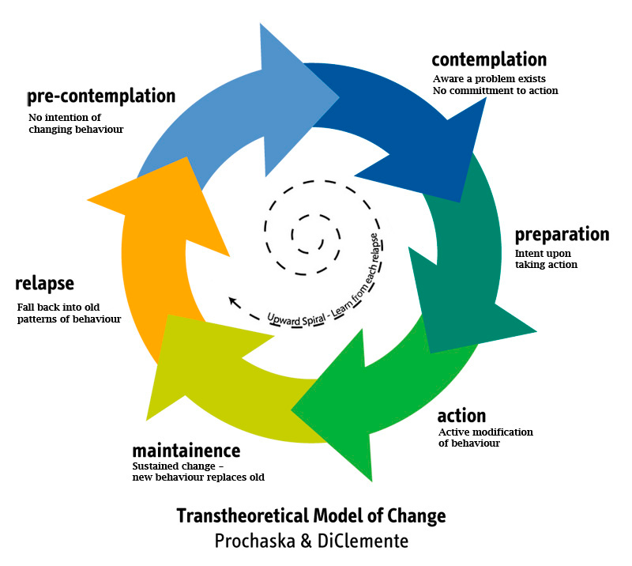
Stages of Change

Slide 10
Strategies to Move through Stages of Change
Express Empathy: Engage in self-talk in a respectful manner– be honest but also give self the benefit of the doubt and acknowledge the good/bad things about making a change.
Develop Discrepancy: Juxtapose problem behavior against beliefs, values, goals. Create discrepancy between who you want to be and who you are during problem behavior.
Conduct a Decision Balance: Lay out all of the relevant reasons for changing, costs of changing, reasons for not changing, costs of not changing.
Roll with Resistance: Understand its natural to resist change and consider making bargains with yourself to make “less” change. Meet yourself wherever you are.
Support Your Own Self-Efficacy: Know change is possible (difficult but possible) and remember past success; Acknowledge/reward any positive steps in the right direction even if not full change.
Develop a Change Plan: Outline what steps are need to make the changes you want to make and start taking those steps to create and maintain change.
Commit to Action: Make a clear state of your intent to change and what you are willing to change.

Slide 11
Functional Analysis
An approach to understand WHY problematic behaviors occur and how those behaviors can be addressed
Can be used to understand the choices made by your students as well as how you respond to your students in an advising role (or even what you do in your own life)
Almost any problem behavior can be explored in a functional analysis – even things that aren’t thought of as behaviors such as procrastination
Notes:
Over the past two months, we have developed an understanding of our emotional wellbeing with some useful strategies to help us make positive changes in our life.
These efforts have focused on particular aspects of our experience such as cognitions or goals.
Last week we discussed motivational enhancement as an approach that can help us strengthen our willingness to change problematic behaviors in our lives.

Slide 12
Trigger (2) | Thoughts (3a) | Feelings (3b)
Problem Behavior (1) | Problem Behavior Positive Consequences (4a) | Problem Behavior Negative Consequence (4b)
Healthy Behavior (5) | Healthy Behavior Positive Consequences (6a) | Healthy Behavior Negative Consequence (6b)

Slide 13
Trigger (2) Current: I often check my email before I go to sleep and something in it is always a problem Recent: Throughout the week I get too little sleep so I’m worn down by later in the evening Early: Lashing out at others was seen as a sign of strength in my family growing up | Thoughts (3a) I should respond to this now People have to understand my perspective Everyone else is the problem because they only ever care about themselves | Feelings (3b) Disappointed in myself that I can’t fix everything and make everyone happy Frustrated that others don’t try to understand my position Anxious about how tomorrow will go
Problem Behavior (1) (START HERE!) I stay up late responding to emails and sometimes write something I wish I hadn’t written (e.g., being aggressive or sarcastic) | Problem Behavior Positive Consequences (4a) I get it over with I feel relieved especially if I send something more aggressive because I stood up for myself | Problem Behavior Negative Consequence (4b) I will hurt my reputation I will lose respect from colleagues I will later feel bad I hurt someone’s feelings
Healthy Behavior (5) Meditate before bed instead of checking email Go to bed by 11:30 Respond in the morning when I have had a good night’s sleep | Healthy Behavior Positive Consequences (6a) Over time this will help my reputation I will avoid doing something I will regret | Healthy Behavior Negative Consequence (6b) I’m not very good at meditation so it will not work very well at first so I might have trouble sleeping as I’ll go to bed frustrated
Notes:
Go through instructor’s personal example. Elicit suggestions from the class about consequences and alternative healthy behaviors. A goal here is to show that different people will have different healthy behaviors that they deem helpful and acceptable in a given situation. Acknowledge that the healthy behaviors might not feel as gratifying/rewarding as the target behavior, but that, in the long run, they have fewer negative consequences.
If there is time, ask for a student volunteer who might be willing to walk through the steps with the instructor in front of the class.
We will complete the worksheet in the following order
1) Problem behavior 2) Trigger 3) Thoughts 4) Feelings 5) PB Consequences
6) Healthy Behavior 7) HB Consequences

Slide 14
Complete one full Functional Analysis Worksheet for yourself and a student
Trigger (2) Current: Recent: Early: | Thoughts (3a) | Feelings (3b)
Problem Behavior (1) | Problem Behavior Positive Consequences (4a) | Problem Behavior Negative Consequence (4b)
Healthy Behavior (5) | Healthy Behavior Positive Consequences (6) | Healthy Behavior Negative Consequence (6b)

Slide 15
Why you got into this work - Revisited
Go back to your paragraph about why you got into this work and/or what you deeply love about it
Take a minute and identify one thing we discussed today and it how you might use it to:
to stay connected to why you got into this work as an advisor; and
to be more focused and emotionally resilient in the face of the significant stressors you are facing generally and particularly now in COVID in your role as an advisor
Lets finish with a brief discussion about what you identified

Slide 16
Questions and Thoughts *for more information please contact me directly at carl.lejuez@uconn.edu

